Slide 1


HEALTH IS WEALTH!!
WELLNESS PREDICTION SUITE
Presented By:
ANEESH KASHETTY
Under Guidance Of
Ms. R KOTESWARAMMA

Slide 2


Overview
01
Introduction
02
Existing System
03
Our Idea
04
Advantages
05
System Design
06
Tech Stack

Slide 3

Introduction
A transformative healthcare innovation poised to empower individuals in their journey towards better health.
Our platform leverages advanced predictive analytics to assess disease risk across a spectrum of medical conditions, from diabetes to malaria.
By providing personalized insights and recommendations, we enable users to make informed decisions and take proactive steps towards improved well-being.
With a commitment to innovation and user-centric care, we aim to revolutionize healthcare by putting the power of prevention and early intervention into the hands of individuals.

Slide 4
Existing System
The existing healthcare system often relies on manual assessments and subjective evaluations, leading to delays in diagnosis and treatment..
Patients typically wait for lab reports and undergo manual assessments by healthcare professionals, prolonging the time between symptom onset and effective intervention.
This manual process can result in inefficiencies and potential errors, highlighting the need for automated systems to streamline diagnostic procedures and improve patient outcomes..
Patients currently rely solely on lab reports and consultations with doctors, lacking guidance on dietary choices.

Slide 5



Our Idea
Continuous Innovation For Health
Holistic Health Focus
Wellness Recommendations
Our solution prioritizes holistic patient care, placing individuals at the center of their healthcare journey to promote overall well-being and long-term health outcomes.
With a commitment to staying at the forefront of healthcare technology, we continuously update and refine our suite with the latest advancements in machine learning and medical research, ensuring accurate and reliable predictions for our users.
Our recommendation system goes beyond disease prediction by offering personalized suggestions for nearby hospitals specialized in the treatment of specific ailments.
Additionally, provides dietary suggestions aligned to user's health

Slide 6




Advantages
Early disease detection enables timely intervention and improves treatment outcomes.
Personalized recommendations for hospitals and dietary empower proactive health management.
Enhanced patient satisfaction by providing personalized care and guidance.
Facilitation of data-driven decision-making leads to better patient care.
Reduction in healthcare costs through preventive measures and optimized resource utilization.

Slide 7

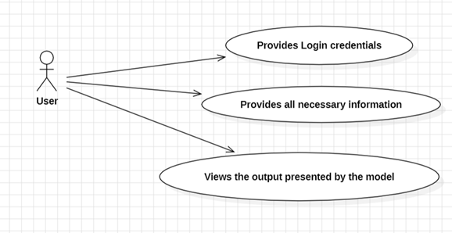

System Design
Use-Case Diagram:
Use-Case Diagram for User

Slide 8
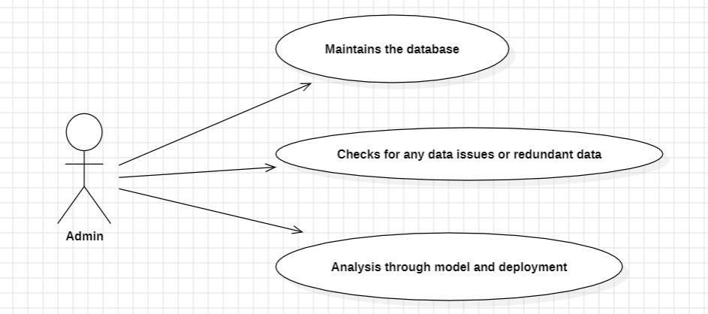
Use-Case Diagram:
Use-Case Diagram for Admin

Slide 9
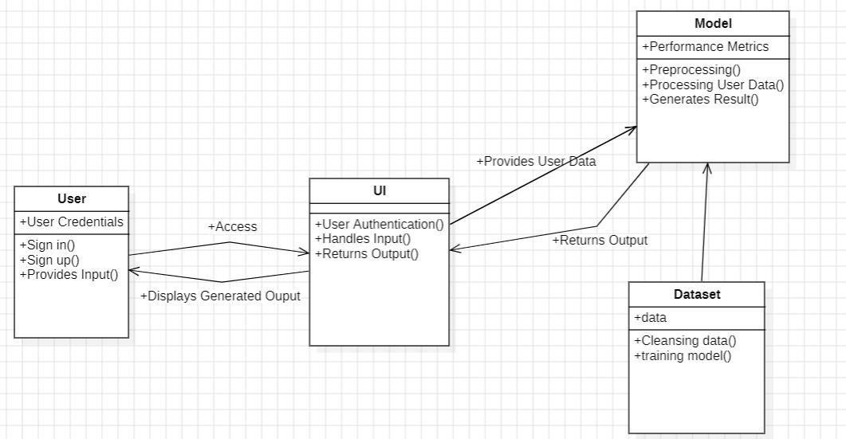
Class Diagram:
Class Diagram For Wellness Prediction Suite

Slide 10
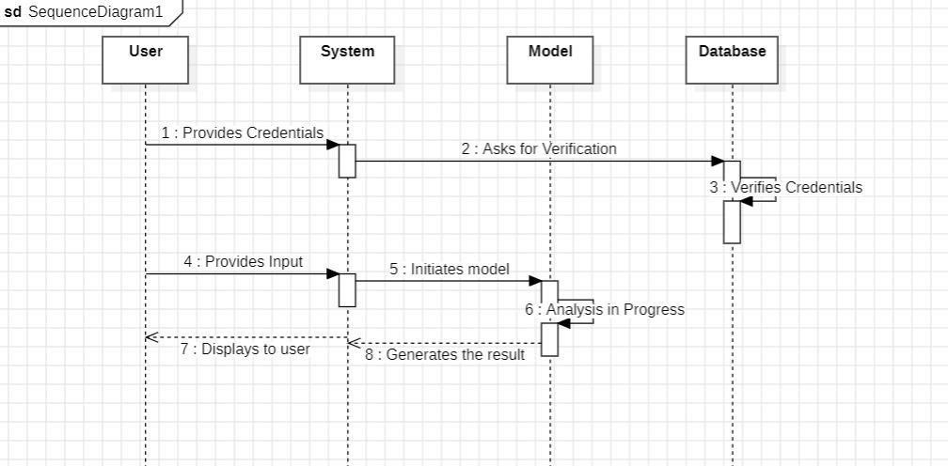
Sequence Diagram:
Sequence Diagram For Wellness Prediction Suite

Slide 11
Tech Stack
Back-End:
Python - Language of choice for data processing, machine learning model development, and backend logic.
Flask - Python web framework for building RESTful APIs to serve predictions, handle user inputs, and manage data.
Front-End:
React.JS - JavaScript library for building dynamic and interactive user interfaces.
Material-UI - UI component libraries for React.js to streamline frontend development.
Machine Learning and Predictive Analytics::
Scikit-Learn - Python library offering a wide range of algorithms for machine learning tasks such as classification, regression, and clustering.
TensorFlow or PyTorch - Deep learning frameworks for building and training neural network models, especially useful for image-based predictions (e.g., X-ray scans)
Pandas and Numpy - Python libraries for preprocessing data and feeding it into machine learning models.
Database:
Mongo-DB - NoSQL database for flexible storage of predictions, and recommendations.

Slide 12

Prioritize health: Prioritize Life
Thanks For Watching

